Slide 1

Business-To-Business E-commerce
11-<number>

Slide 2
The focus of this chapter is on several learning objectives
The meaning, benefits, and opportunities in B2B
B2B building blocks and their relationship to supply chain management
Key B2B models and their main functions
EDI as a B2B tool
Role of leadership in B2B as an ongoing concern
11-<number>

Slide 3
What Is B2B?
Business has always been about exchange
Money as economic value eliminates barter
Today money is exchanged by the invisible transfer of funds between businesses via computer business relationships
The Unique contribution of B2B e-commerce is in the way these relationships are established and maintained. B2B is a network of independent organizations involved in a business area or an industry
B2B focuses on the concept of exchange
Efficiency is a factor
11-<number>

Slide 4
Factors Driving B2B
Today’s customer has become more cost conscious and value conscious and demands quality products in a timely manner
Maturation of information technology and networks makes it possible to design a supply chain to meet customer demand
The global dimension, involving distance, costs, time, variety, and uncertainty, makes it almost mandatory that the long supply chains be managed efficiently around the clock
11-<number>

Slide 5
What Is B2B E-commerce?
Alternative ways of executing transactions between buyers and sellers that are business organizations; a network of independent organizations and long-term trading partners
What is involved in B2B?
  Complex procurement, manufacturing, and planning collaboration
  Complex payment terms
  Round-the-clock performance
11-<number>

Slide 6
Examples of B2B
Messaging products for facilitating secure, reliable data movement between trading partners
Work flow and process flow products for implementing conversational logic
Trading partner management products for helping identify where the data need to go and how they should get there
Directories for assisting businesses in locating other businesses that provide a particular service or product
11-<number>

Slide 7
Elements of B2B
Buying company
  Announces RFP of a certain products on its web site
  Participating suppliers in B2B network sends their bid
Selling company
  Attracts the buying organizations to their site
  Has unique catalog, pricing policy and discount schedule
Intermediating service provider
  For ensuring order fulfillment
  Mediates between buying company and seller/suppliers
JIT deliverer
  For on time delivery of products
11-<number>

Slide 8
Elements of B2B
Web-based platform
  Internet, Intranet and Extranet
B2B tools like electronic data interchange (EDI)
  Electronic exchange of business documents like bills, orders and shipping notice between business partners
  Designed to convert proprietary data into digitally transmittable format
Back-end technical support
  Focus on ERP
  Integrating B2B with technical infrastructure
11-<number>

Slide 9
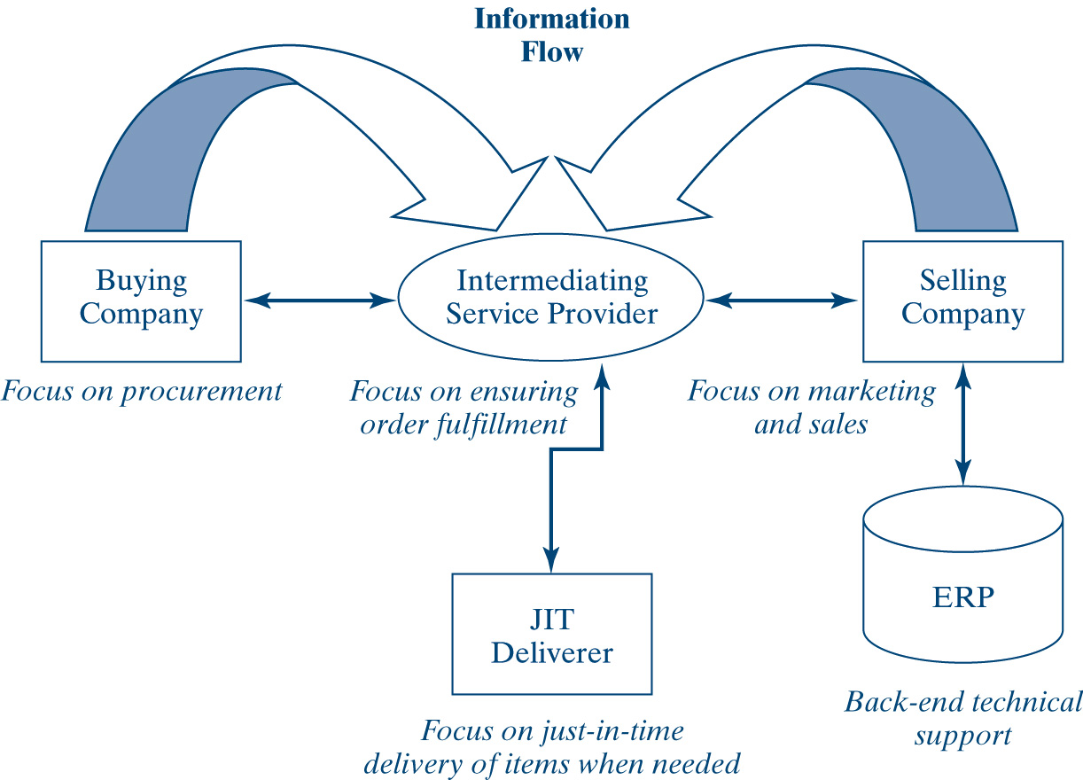
Key B2B Entities
11-<number>

Slide 10
Comparing B2B and B2C
The connection mechanism
  consumer to Server
  Server to Server
Type of relationship
  Placing order, executing payment
  Online procurement, order fulfillment, work in progress tracking
Nature of control
  Unidirectional, seller controls the relationship
  Unidirectional or Peer-to-peer
Nature of needs-based segmentation
  generalized
  customizable
Sales complexity
  Lower
  higher
11-<number>

Slide 11
Advantages and Disadvantages of B2B
Advantages
  Replacing a purchasing bureaucracy with online links means savings
  Improved efficiency in ordering material
  Many fewer errors
  Just-in-time environment that minimizes inventory sitting in the warehouse
Disadvantages
  Possible antitrust violations
  Low barriers to entry for competitors
11-<number>

Slide 12
Supply-Chain Management and B2B
The supply chain represents all the events associated with the flow and transformation of goods from the raw material stage to the end-user customer
(SCM) refers to overseeing materials, information, and finances as they move from supplier to manufacturer to wholesaler to retailer to consumer
Ultimate goal is to reduce inventory
Main types of SCM systems
  Planning applications
  Execution applications
11-<number>

Slide 13
SCM Life-Cycle Process
Plan
Source
Make
Deliver
Return
11-<number>

Slide 14
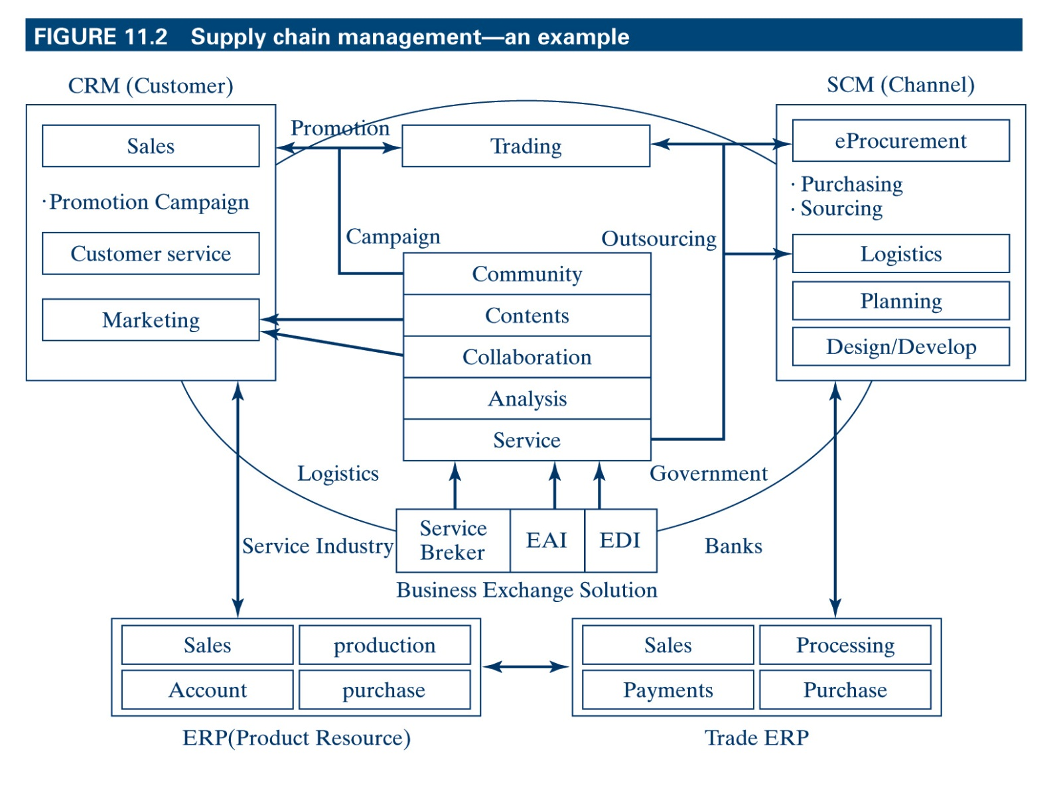
Supply Chain Management – an example
11-<number>

Slide 15
B2B Building Blocks
The application server
  To develop, manage and execute B2B services and traffic for high-performance and non stop service
The B2B integration server
  Joins company, external and application data for quick, reliable and secure service
The personalization software
  Makes possible to provide only the contents to the partners that are unique to them
The content management facility
The e-commerce package
  Customer service and product management.
  Storefront for direct delivery, shopping cart and order fulfillment module
11-<number>

Slide 16
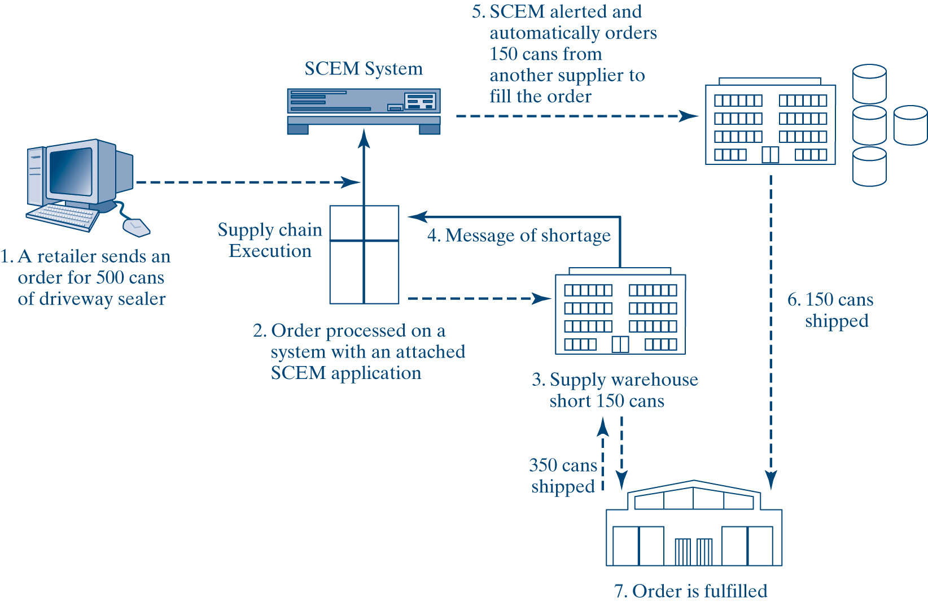
Supply Chain Event Management
11-<number>

Slide 17
Trust in E-commerce
The core of collaborative relationships over time is trust
Trust elements
  Competence - the ability of the parties in the chain to meet commitments
  Cognitive and affect-based trust that assures you the vendor means well and stands by his or her reputation
  Vulnerability - choosing a course of action even if such action has a probability of failure greater than 50 percent
11-<number>

Slide 18
Disaster Planning
What if the chain snaps?
Disaster planning - taking specific steps to ensure the flow of products and services during a disaster
Growing awareness of the need for disaster planning so that the chain can keep operating
Work with the highest-risk customers and collaborate on a contingency plan to suit their needs in the event of a disaster
Empower employees on supply-chain disruptions and how to communicate effectively to minimize unnecessary delays
11-<number>

Slide 19
B2B Models
Buyer-Oriented B2B
Supplier-Oriented B2B
Electronic Auctions
  Forward Auction
  Reverse Auction
Internet Exchange Auctions
11-<number>

Slide 20
B2B Models
Buyer-Oriented B2B
  a buyer purchases thousands of products
  uses the Internet to open a marketplace and a Web site
  suppliers do the bidding on the web site
  Buyer selects the supplier with the best price
11-<number>

Slide 21
B2B Models
Supplier-Oriented B2B,
  a supplier invites individual consumers and business customers to order products via its electronic market store
  good example of this type of company is dell and cisco
11-<number>

Slide 22
B2B Models
Electronic Auctions:
  Seller offers a product or an item for sell (putting an item up for bid) but do not set a price
  Interested buyer get information an compete on price to get the product
  auctions carried out on electronic Web sites such as eBay
  Forward Auction
    seller entertains bids from buyers; an auction used to liquidate merchandise
  Reverse Auction is an auction used to solicit bids; the lowest bidder wins
11-<number>

Slide 23
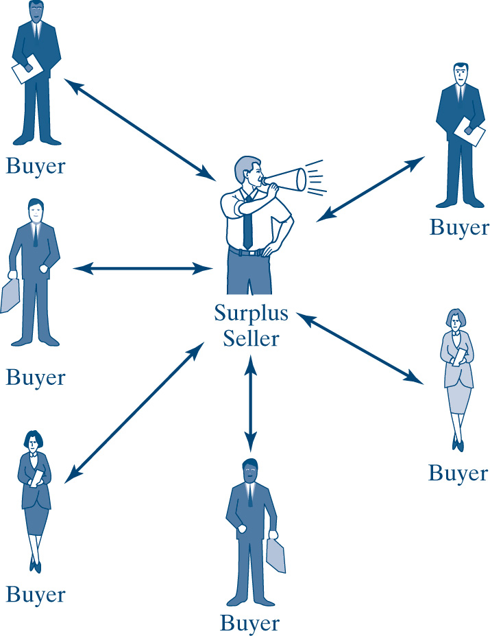
B2B Models
Forward Auction
    Supplier oriented
    seller entertains bids from many buyers;
    Most often used to liquidate merchandise
    May be transparent or blind.
11-<number>

Slide 24
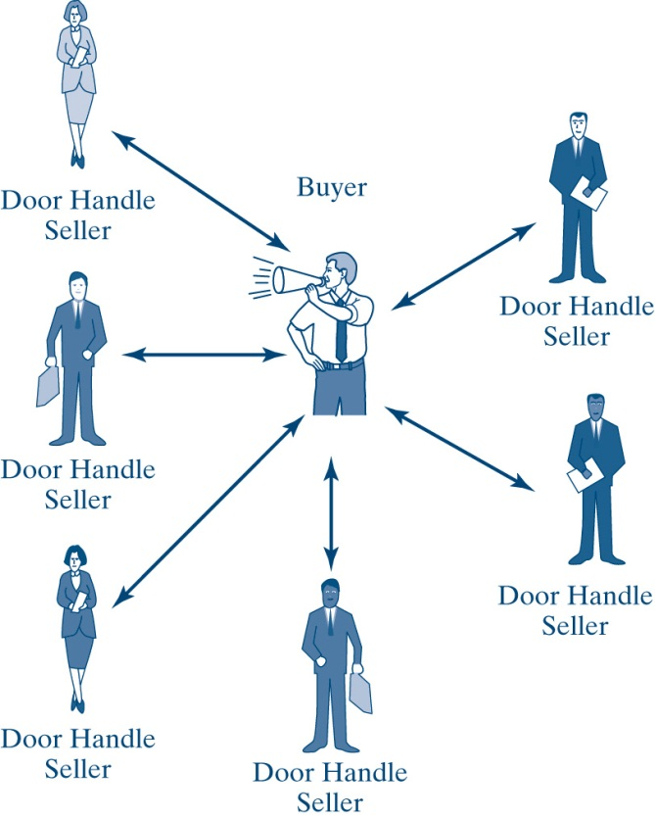
B2B Models
Reverse Auction
  Buyer controlled
  Buyer posts the goods they wants to buy
  Supplier/ seller compete to provide them
  the lowest bidder wins
11-<number>

Slide 25
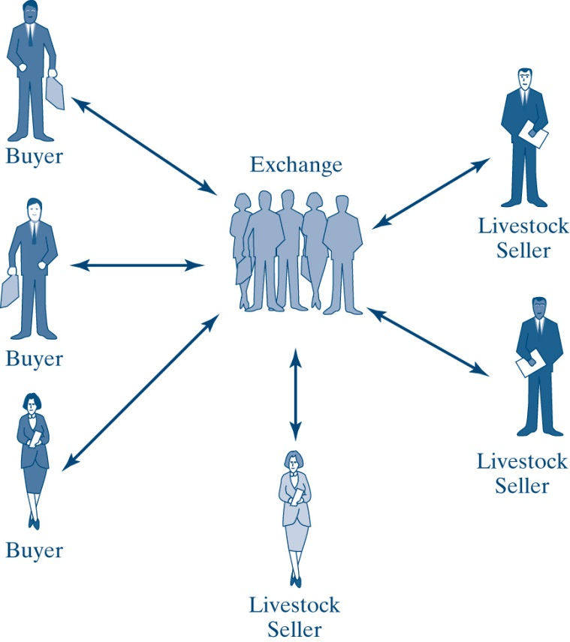
B2B Models
Internet Exchange Auctions
  an electronic auction involving many buyers and sellers who trade bids and offers until an agreement is reached to exchange product for payment. A third party often operates the exchange
11-<number>

Slide 26

B2B Models (Cont’d)
Intermediary-Oriented B2B, an intermediary company establishes an exchange market where buyers and sellers can make deals
11-<number>

Slide 27
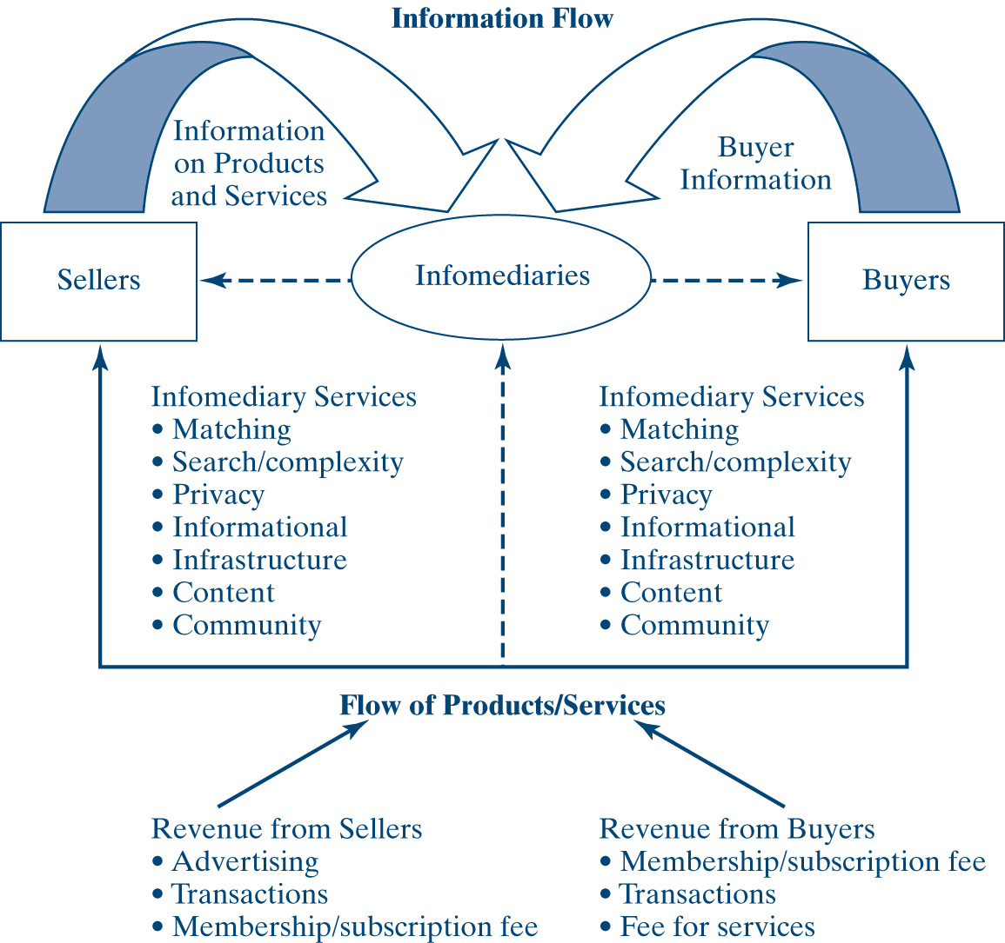
Intermediary Model
11-<number>

Slide 28
Electronic Data Exchange
A computer-to-computer transfer of business information (transaction data, RFQ, order ack., shipping status) among businesses that use a specific standard format
EDI components:
  Interbusiness :transmission of data between business
  Computer-to-Computer: Data communication between computer to Computer
  Standard transactions: Electronic version of standard business documents.
  Standard format:
11-<number>

Slide 29
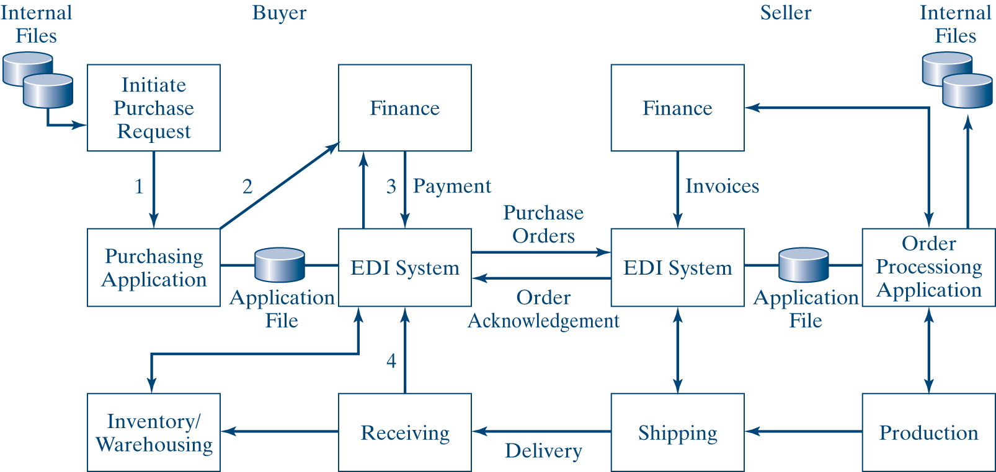
Information Flow Between Buyer and Seller with EDI
11-<number>

Slide 30
EDI Advantages and Drawbacks
Benefits
  Cost reduction and time savings
  Improved B2B problem resolution
  Accuracy with integrity
Drawbacks
  EDI has yet to catch on as the perfect solution to information flow or for doing business.
  EDI is point to point.
  EDI requires expensive VAN networking to operate at peak efficiency.
  EDI is not easy to use, learn, or implement.
11-<number>

Slide 31
Justifying EDI
Conditions justifying EDI implemention
  Volume of data
  Frequency of document transmission and reception
  Content sensitivity
  Time sensitivity
An alternative is Web-based EDI
11-<number>

Slide 32
Management Implications
The goal of B2B is to line up partners, work with the partners, and allow the partners to compete for lowest price
The changes in B2B are so intense that technology has become a mere enabler, not a solution
Compensation is a major issue and always will be a high priority
IT employees should be involved in the decision process, especially in projects that affect their jobs
11-<number>

Slide 33
Chapter Summary
B2B involves complex procurement, manufacturing, planning collaboration, payment terms, and round-the-clock performance agreements
B2B and B2C have distinctive characteristics
Among the advantages of B2B are suppliers using the purchaser’s Web site to respond online to bids and sell excess inventory
B2B is part of the supply-chain process
11-<number>

Slide 34
Chapter Summary (Cont’d)
Among the models in B2B e-commerce are:
  Buyer-oriented B2B
  Supplier-oriented B2B
  Electronic Auction
  Intermediary-oriented B2B
B2B integration is about coordinating information among partners and their information system infrastructure
Most B2B traffic is handled by EDI, which is computer-to-computer transfer of business information between two businesses that use a specific standard format
11-<number>

